Slide 1
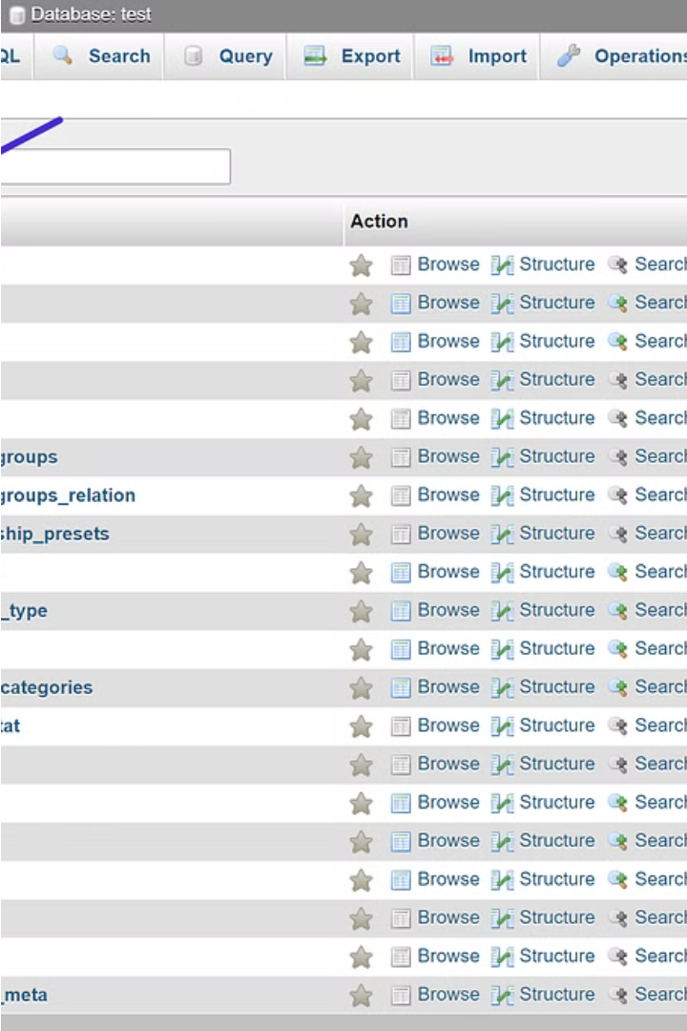

Introduction of GROUP BY, HAVING, and WHERE
Dive into the world of SQL data analysis with the powerful GROUP BY, HAVING, and WHERE clauses. These tools empower you to aggregate, filter, and refine your data, unlocking valuable insights from your MySQL database.
by Jeyapathy

Slide 2
Grouping and Calculating with GROUP BY
Grouping Data
Performing Calculations
Unlocking Insights
The GROUP BY clause allows you to group rows that have the same values into summary rows, providing a way to perform calculations on subsets of the data.
By grouping and calculating, you can uncover deeper insights, such as total sales by product category or average customer spending by region.
With GROUP BY, you can apply aggregate functions like SUM, AVG, COUNT, and MAX to calculate values for each group, revealing patterns and trends in your data.

Slide 3
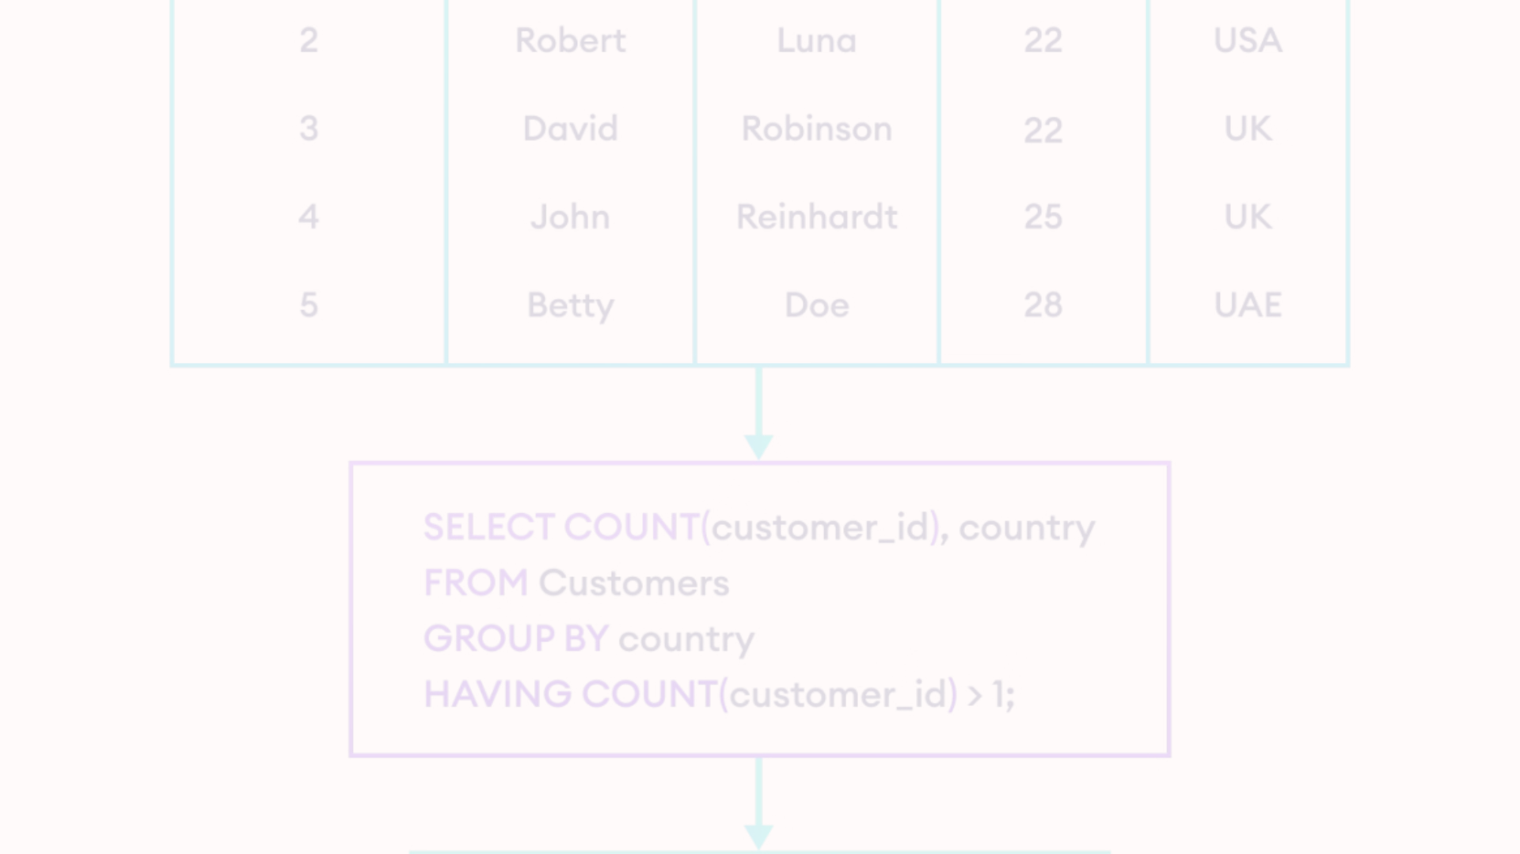



Refining with HAVING and WHERE
WHERE Clause
HAVING Clause
Powerful Combination
The WHERE clause filters the rows before they are grouped, allowing you to focus on specific subsets of data.
The HAVING clause filters the groups after the grouping and aggregation have been performed, enabling you to refine the results further.
Together, WHERE and HAVING provide a powerful way to analyze your data, ensuring you only see the most relevant and meaningful information.

